Slide 1



PiDiNet
Pixel Difference Networks for Efficient Edge Detection
---
Group Members
Fahad Ali Aslam
Omer Zeeshan
Salman Ahmad
Instructor: Dr. Muhammad Jameel Nawaz

Slide 2
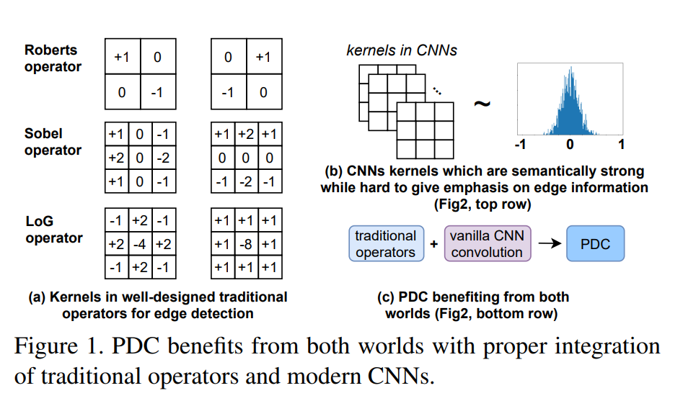
PiDiNet – Pixel Difference Networks for Efficient Edge Detection
Dataset Used
PiDiNet adopts novel pixel difference convolutions that integrate the traditional edge detection operators into the popular convolutional operations in modern CNNs for enhanced performance on the task, which enjoys the best of both worlds.
BSDS500
NYUD
MDBD
Berkeley Segmentation Dataset (500 Natural Images)
NYU Depth V2
(Indoor Video Sequences)
Multicue Dataset for Boundary Detection
(early visual cues i.e. luminance)
Goal:
Detect object boundaries accurately while using far less computation, memory and training data than large CNN edge detectors.
Key idea:
Explicitly compute local pixel differences before convolution, injecting gradient/edge cues into learnable CNN features.
PiDiNet combines this operation with a slim backbone, residual shortcuts and an efficient side structure that fuses edge maps from four stages.
PiDiNet
DOI: 10.1109/ICCV48922.2021.00507
2

Slide 3
Pixel Difference Convolution (PDC)
Vanilla convolution
Local pixels → weighted sum
Learns useful patterns,
but has no explicit
preference for gradients.
PDC
1. Select pixel pairs
2. Compute differences
(xᵢ − xᵢ′)
3. Multiply differences
by learnable weights
4. Sum → output feature
Why this helps
Pixel differences directly
respond to local intensity,
color or texture changes.
These changes are exactly
where edges tend to occur.
y = Σ wᵢ xᵢ
y = Σ wᵢ (xᵢ − xᵢ′)
PiDiNet
DOI: 10.1109/ICCV48922.2021.00507
3

Slide 4
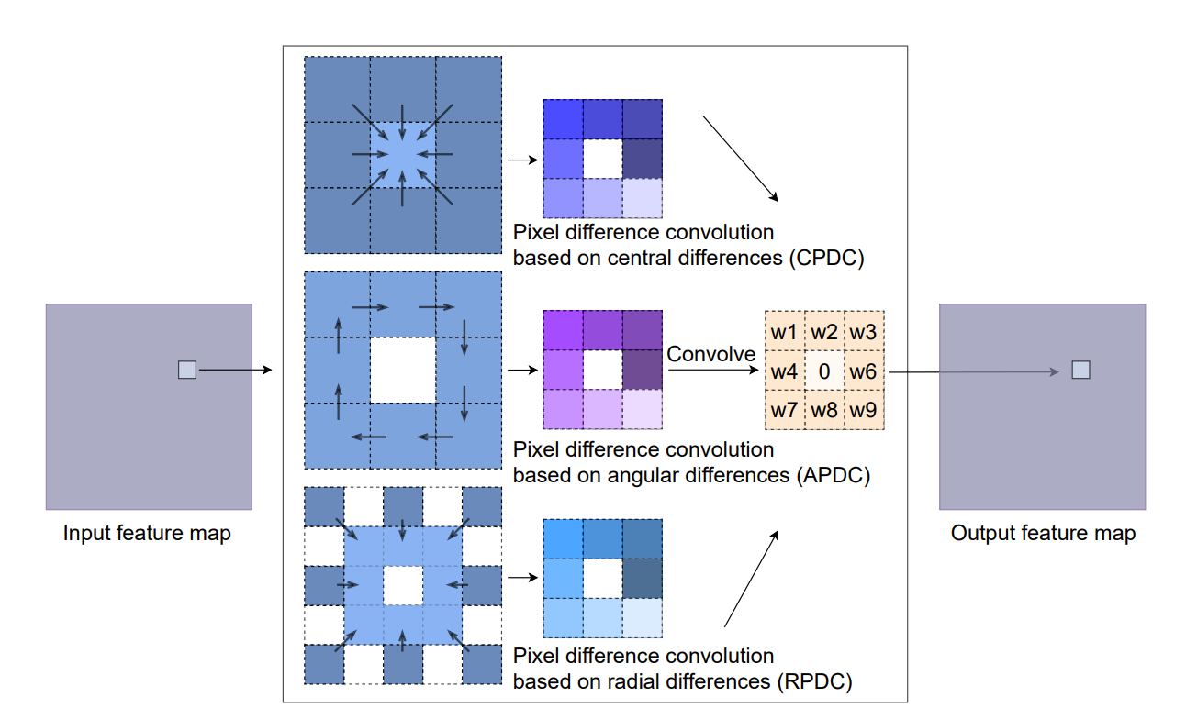
Pixel Difference Convolution (PDC)
Different pair-selection patterns capture complementary gradient information
PiDiNet uses a mixed sequence: [CPDC → APDC → RPDC → Vanilla] repeated across the four stages.
PiDiNet
DOI: 10.1109/ICCV48922.2021.00507
4

Slide 5
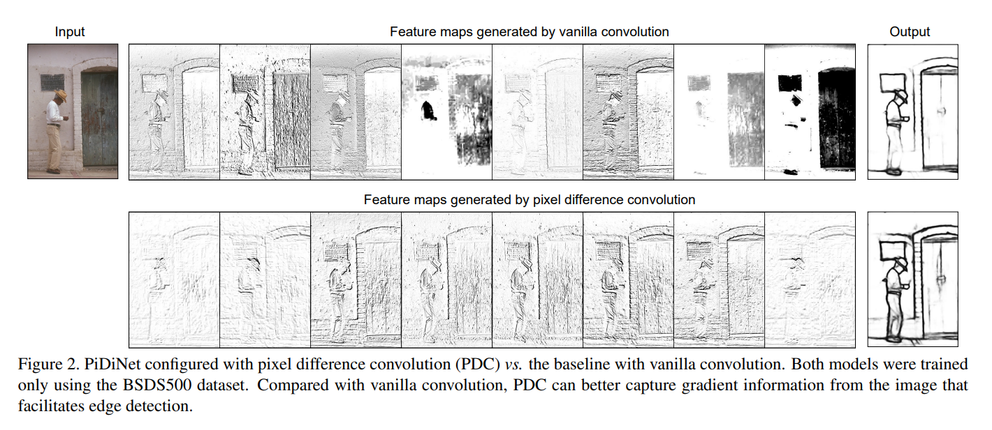
PiDiNet – PDC vs Vanilla Convolution
PDC can better capture gradient information from the image that facilitates edge detection.
PiDiNet
DOI: 10.1109/ICCV48922.2021.00507
5

Slide 6
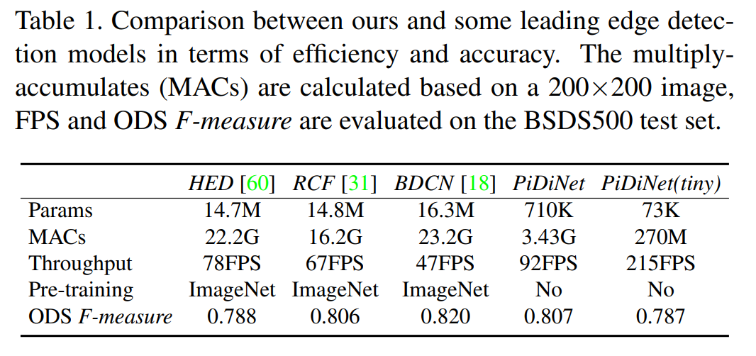
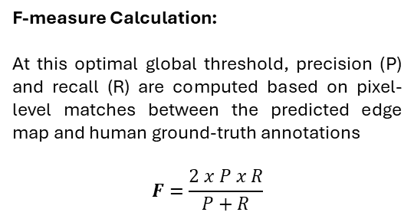
PiDiNet – Comparison with other Edge Detection Models
The Optimal Dataset Scale (ODS) F-measure
is a standard evaluation metric used in computer vision—particularly for edge and contour detection—that applies a single, global binarization threshold across an entire test dataset to maximize the overall F-score.
F-measure Calculation:
At this optimal global threshold, precision (P) and recall (R) are computed based on pixel-level matches between the predicted edge map and human ground-truth annotations
$$F=\frac{2 x P x R}{P+R}$$
22X
4.66X
0.807
Role in Evaluation:
It measures how well a generalized edge detector performs across diverse scenes without fine-tuning the operating threshold per image.
Less Parameters
Then HED, RCF, BDCN
Less MACs
Lower MAC means faster
Improved ODF F measure
Except BDCN
PiDiNet
DOI: 10.1109/ICCV48922.2021.00507
6

Slide 7
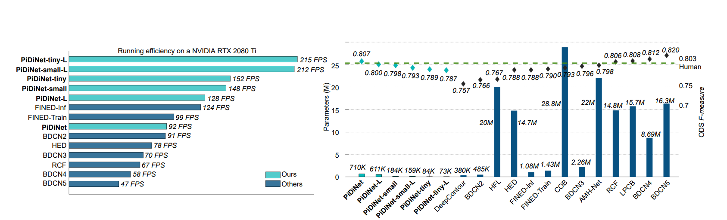
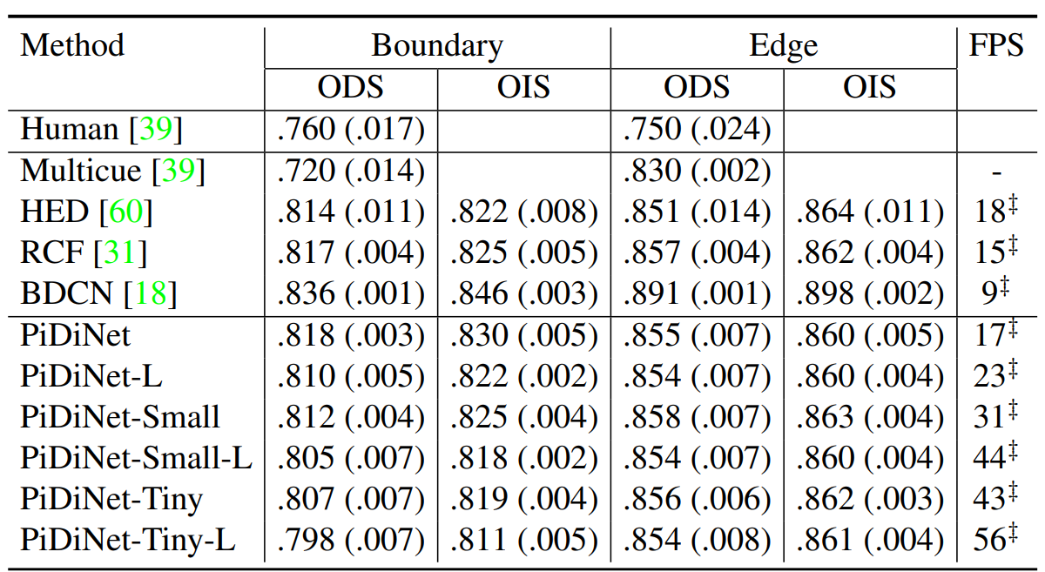
PiDiNet – Comparison with other Edge Detection Models
PiDiNet
DOI: 10.1109/ICCV48922.2021.00507
7

Slide 8


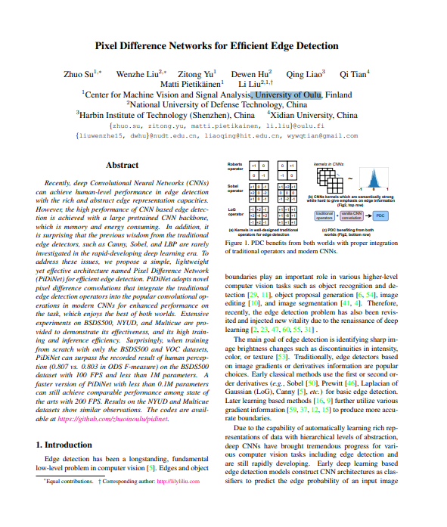
PiDiNet – Key Contributions
ICCV 2021
KEY Contributions
`
Re-parameterization trick
every PDC is algebraically foldable into a single ordinary convolution kernel after training (no retraining, no approximation), so inference runs as a plain fast CNN despite training with the richer difference-based operators.
PiDiNet
PiDiNet
Extreme parameter efficiency
The full model uses well under 1M parameters (as low as ~0.07M for the Tiny variant), 10-40x smaller than typical CNN-backbone-based edge detectors like HED/RCF.
PiDiNet
Trained entirely from scratch
No ImageNet or other large-scale pretrained backbone required, unlike prior deep edge detectors.
PiDiNet
State-of-the-art accuracy despite the small size
0.807 ODS on BSDS500, surpassing the recorded human perception baseline (0.803).
PiDiNet
High speed
Up to 100+ FPS on GPU (Tiny variant up to 200+ FPS), making it practical for real-time and edge/embedded deployment.
PiDiNet
Consistent gains across datasets
improvements hold on BSDS500, NYUD, and Multicue, not just one benchmark.
PiDiNet
Bridges classical and deep learning edge detection
revives and validates ideas from traditional operators (Canny/Sobel/LBP) inside a modern trainable deep learning framework, an angle largely ignored by prior deep detectors.
PiDiNet
DOI: 10.1109/ICCV48922.2021.00507
8

Slide 9
PiDiNet – Training Environment
Hardware
RTX 4050 Laptop GPU (6GB) · CUDA 13.1 driver
Framework
Python 3.13 venv · PyTorch 2.6.0+cu124 · torchvision 0.21.0+cu124
Source
Official repo: github.com/hellozhuo/pidinet — checkpoints already included in-repo
First hurdle
Paper's exact training-data mirrors (mftp.mmcheng.net) was dead,
Raw BSDS500 (Berkeley Segmentation Dataset 500) — the original academic dataset from UC Berkeley's Computer Vision Group
Augmented HED-BSDS.tar (28,800 training pairs) —The RCF repo's own mirror (mmcheng.net) is dead, so we got it from a UC San Diego mirror instead: vcl.ucsd.edu/hed/HED-BSDS.tar
Workaround
Used the still-live official raw BSDS500 from Berkeley + our own conversion script
PiDiNet
DOI: 10.1109/ICCV48922.2021.00507
9

Slide 10
PiDiNet – What the model is trained on
1
300 images x 96 variants = 28,800 pairs
edge_dataloader.py: BSDS_Loader (condensed)
BSDS500 train (200) + val (100) images, each pre-augmented: 16 rotation angles x 2 flip states x 3 scales (0.5, 1.0, 1.5). The 200 test images are never used for training.
lb = np.array(Image.open(gt_png), dtype=np.float32)
# soft edge map 0..255
lb[lb == 0] = 0 # background
lb[(lb > 0) & (lb < thr)] = 2 # ambiguous: ignored
lb[lb >= thr] = 1 # edge
# thr = 0.3 * 256 = 76.8 (--eta 0.3)
img = ToTensor()(img) # 0..1
img = Normalize(mean=[0.485, 0.456, 0.406],
std=[0.229, 0.224, 0.225])(img)
# label values the loss will see:
# 0 = background, 1 = edge, 2 = ignore
2
Augmentation is already on disk
Folders such as train/aug_data/22.5_1_0 hold one variant of all 300 images, so the loader itself does no augmentation, only tensor conversion and normalisation.
3
One line of train_pair.lst
train/aug_data/0.0_1_0/100075.jpg
train/aug_gt/0.0_1_0/100075.png
(image, then its edge map). batch_size=1, shuffle=True: images differ in size, so we accumulate gradients instead (next slide).
PiDiNet
DOI: 10.1109/ICCV48922.2021.00507
10

Slide 11
PiDiNet – training step, line by line
main.py: train() (simplified)
1
Five predictions
for i, (image, label) in enumerate(train_loader):
outputs = model(image.cuda())
# 5 maps: e1, e2, e3, e4 and the fused map
loss = 0
for o in outputs: # deep supervision
loss += cross_entropy_loss_RCF(o, label, 1.1)
loss = loss / args.iter_size # iter_size = 24
loss.backward() # gradients add up
counter += 1
if counter == args.iter_size: # every 24 images
optimizer.step() # one weight update
optimizer.zero_grad()
counter = 0
The backbone returns four stage maps plus the fused map, all full-size, sigmoid already applied.
2
Same label, five losses
Every output is scored against the same ground truth and the losses are summed.
3
Effective batch of 24
One image per step, weights updated every 24 images: 28,800 / 24 = 1,200 updates per epoch.
4
What the log shows
The printed loss is the sum over those 24 images and 5 outputs, which is why it reads in the thousands.
PiDiNet
DOI: 10.1109/ICCV48922.2021.00507
11

Slide 12
PiDiNet – Optimizer, learning-rate schedule and what we got
main.py + utils.py
Epoch | Learning rate | Baseline CNN loss | PiDiNet-full loss
1 | 0.005 | 9,509 | 9,342
2 | 0.0005 | 7,828 | 8,048
3 | 0.00005 | 7,522 | 7,837
param_groups = [
{'params': conv_weights, 'weight_decay': wd, 'lr': lr},
{'params': bn_weights, 'weight_decay': 0.1 * wd, 'lr': lr},
{'params': relu_weights, 'weight_decay': 0.0, 'lr': lr}]
optimizer = torch.optim.Adam(param_groups, betas=(0.9, 0.99))
def adjust_learning_rate(optimizer, epoch, args): # multistep
lr = args.lr # 0.005
for step in args.lr_steps: # --lr-steps 1-2
if epoch >= step:
lr = lr * 0.1
Average training loss per epoch from the run logs (3 epochs, 28,800 pairs, iter-size 24).
Loss is not the score
The baseline ended with the lower training loss (7,522 vs 7,837), yet PiDiNet-full scored the higher ODS (0.781 vs 0.777). Training loss measures fit, not edge quality.
Saved every epoch
Cost on the RTX 4050
checkpoint_000..002.pth hold weights and optimiser state; pidinet_log.txt gets one line per epoch.
About 1.3-1.5 s per update, 27-31 min per epoch, 80-90 min for 3 epochs.
PiDiNet
DOI: 10.1109/ICCV48922.2021.00507
12

Slide 13
PiDiNet – From checkpoint to ODS / OIS
main.py --evaluate
edge maps
eval_ods_ois.py
ODS / OIS
load checkpoint, optionally convert PDC to plain conv
model(image)[-1] saved as .png and .mat for the 200 test images
match edges to the human annotations at 25 thresholds
dataset-level and per-image best F-measure
eval_ods_ois.py: the core, per threshold t
How it is scored
pred_thin = skeletonize(pred >= t) # 1-pixel-wide edges
pred_pts = np.argwhere(pred_thin)
d_gt, _ = gt_tree.query(pred_pts) # nearest GT pixel
tp_p = (d_gt <= max_dist).sum() # predicted pixels that hit
d_pred, _ = cKDTree(pred_pts).query(gt_pts)
tp_r = (d_pred <= max_dist).sum() # GT pixels that were found
precision = tp_p / len(pred_pts)
recall = tp_r / len(gt_pts)
Ground truth = union of all annotators. max_dist = 0.0075 x image diagonal (about 4 px). ODS pools the counts over all 200 images and takes the best threshold; OIS takes each image's own best threshold and averages.
Why it is only approximate
The official benchmark matches pixels one-to-one; we use nearest-neighbour distance. Checked on the paper's checkpoints: 0.792 / 0.802 vs official 0.798 / 0.816 (baseline), 0.798 / 0.809 vs 0.807 / 0.823 (full).
PiDiNet
DOI: 10.1109/ICCV48922.2021.00507
13

Slide 14
PiDiNet – Implementation on BSDS500 Dataset
Model | Params | ODS | OIS | FPS
Baseline (vanilla CNN) | 2.7M | 0.798 | 0.816 | 101
PiDiNet (full) | 0.71M | 0.807 | 0.823 | 96
PiDiNet-L | 0.71M | 0.800 | 0.815 | 135
PiDiNet-Small | 0.22M | 0.798 | 0.814 | 161
PiDiNet-Tiny | 0.07M | 0.789 | 0.806 | 182
Training: Baseline CNN, retrained (RTX 4050) | 3 epoch | 2.7M | 0.777* | 0.788* | 30.4
Training: PiDiNet-full, retrained (RTX 4050) | 3 epoch | 0.71M | 0.781* | 0.790* | 27.7
PiDiNet-Tiny keeps 98% of the full model's ODS with 10x fewer parameters - the paper's efficiency headline.
*Our rows: no MATLAB, so ODS/OIS come from our own Python evaluator (nearest-neighbor pixel matching, not the official bipartite correspondence) –
validated by re-scoring both PRETRAINED checkpoints with it first (baseline: 0.792/0.802 vs. official 0.798/0.816; full: 0.798/0.809 vs. official 0.807/0.823), both close matches.
Our 3-epoch retrains land ~0.02 below their pretrained, fully-trained counterparts
PiDiNet
DOI: 10.1109/ICCV48922.2021.00507
14

Slide 15
PiDiNet – Training both PDC vs Vanilla
We trained BOTH the vanilla baseline and the full PiDiNet (config @ CPDC/APDC/RPDC) on the exact same 28,800-pair real dataset, same 3 epochs, same GPU — isolating the effect of the pixel-difference operators alone. (Took 79Min CNN vs 92min PIDNET for 3 epochs)
Baseline (Vanilla CNN)
PiDiNet-full (PDC)
ODS
OIS
ODS
OIS
0.7767
0.7883
0.7811
0.7895
30.4 FPS · 2.7M vs 0.71M params
27.7 FPS · 2.7M vs 0.71M params
Same direction as the paper's own result
PiDiNet-full beats baseline by +0.0044 ODS here (both under-trained, 3 epochs). The paper's own fully-trained (20-epoch) numbers show the same direction at +0.009 ODS (0.807 vs 0.798) — our quick, self-run ablation independently reproduces the paper's central claim: the pixel-difference operators help, not just the CSAM/CDCM wrapper both models share.
PiDiNet
DOI: 10.1109/ICCV48922.2021.00507
15

Slide 16
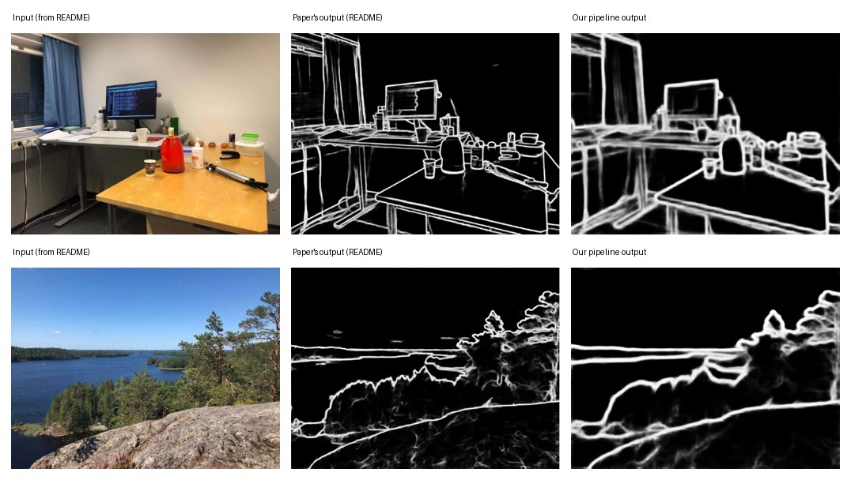
PiDiNet – Reproducing the paper's own README demo
Ran the official table5_pidinet checkpoint on the exact two photos from the GitHub README, and compared our output against the output the authors show.
PiDiNet
DOI: 10.1109/ICCV48922.2021.00507
16

Slide 17
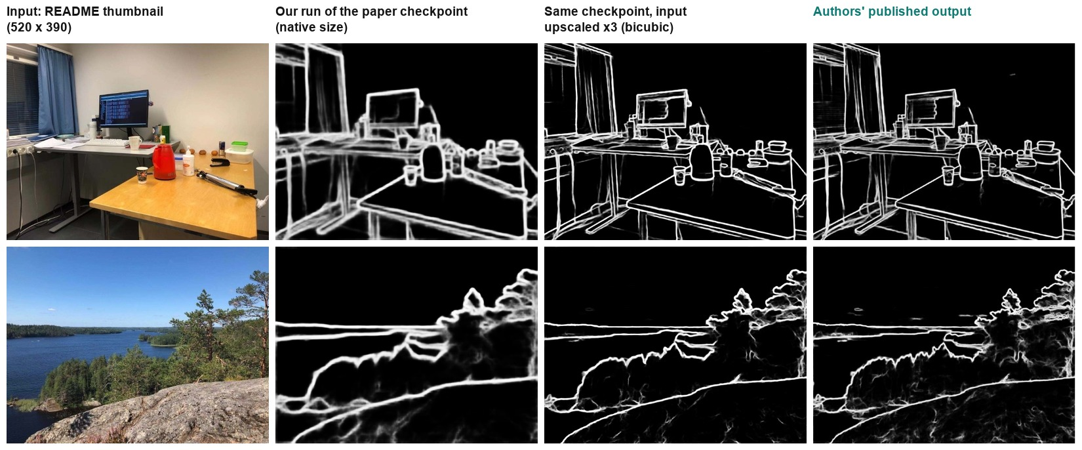
PiDiNet – Resolution matters: why our first run looked softer
The README figure only holds ~520x390 thumbnails. Run at that size, the paper's own checkpoint gives thick, soft edges (column 2). Upscaling the same thumbnail x3 (bicubic, no new detail) gives thin, crisp maps nearly identical to the authors' (columns 3 vs. 4), which is consistent with the authors having run the original full-resolution photos. PiDiNet's edge width depends on the input resolution; for sharper maps, feed larger images.
PiDiNet
DOI: 10.1109/ICCV48922.2021.00507
17

Slide 18
PiDiNet – Training loss over 60 epochs (first run 200 images | 3 epochs)
17,938 → 6,527
loss drop from epoch 0 to 59 (–63%)
Converges fast
by ~epoch 30, thanks to the small 200-image set
Caveat
no PASCAL/flip/rotation augmentation → generalizes worse than the paper's checkpoint
PiDiNet
DOI: 10.1109/ICCV48922.2021.00507
18

Slide 19
PiDiNet – how one image becomes 11 results (compare_edges.ipynb)
Classical (CPU)
run_sobel, run_roberts, run_canny. OpenCV and scikit-image, nothing learned.
Image
timed(fn, input)
Results
HED (GPU)
cv2.imread gives BGR; RGB and grey copies are made once
run_hed. The original Caffe weights copied into the repo's PyTorch HED.
One warm-up call, then the average of 3 runs in ms. Outputs are copied to the CPU, so GPU work has finished.
outs[name] = uint8 map. Saved as one PNG per method and one comparison grid with the ms in each title.
PiDiNet family (GPU)
run_pidinet x 6: paper Baseline, Tiny, Small, Full and our Baseline and Full.
PiDiNet
DOI: 10.1109/ICCV48922.2021.00507
19

Slide 20
PiDiNet – Code: one notebook, 11 edge detectors
PiDiNet: load paper OR our own checkpoint (GPU)
Classical (CPU) + HED (GPU)
def load_pidinet(arch, config, ckpt, converted):
args = SimpleNamespace(config=config, sa=True, dil=True)
name = arch + ("_converted" if converted else "")
model = getattr(models, name)(args)
state = torch.load(ckpt, map_location="cpu",
weights_only=False)["state_dict"]
state = {k.replace("module.", "", 1): v
for k, v in state.items()}
if converted:
state = convert_pidinet(state, config) # PDC -> conv
model.load_state_dict(state)
return model.to(device).eval()
@torch.no_grad()
def run_pidinet(model, rgb):
x = ((rgb / 255.0 - MEAN) / STD).transpose(2, 0, 1)[None]
y = model(torch.from_numpy(x).to(device))[-1] # fused map
return (255 * y[0, 0].cpu().numpy()).astype(np.uint8)
Sobel hypot(cv2.Sobel x, cv2.Sobel y)
Roberts skimage.filters.roberts(blur)
Canny cv2.Canny(blur, 0.4*hi, hi)
hi = 95th pct of image gradient
HED Caffe weights copied into the
repo's PyTorch HED, run on GPU
Run and compare
LOADED = {label: load_pidinet(a, c, k, v)
for label, a, c, k, v in PIDINET_MODELS}
# 4 paper + 2 ours (baseline, PiDiNet)
outs, ms = compare_image(IMAGE)
# 11 methods -> grid PNG + 1 PNG each
PiDiNet
DOI: 10.1109/ICCV48922.2021.00507
20

Slide 21
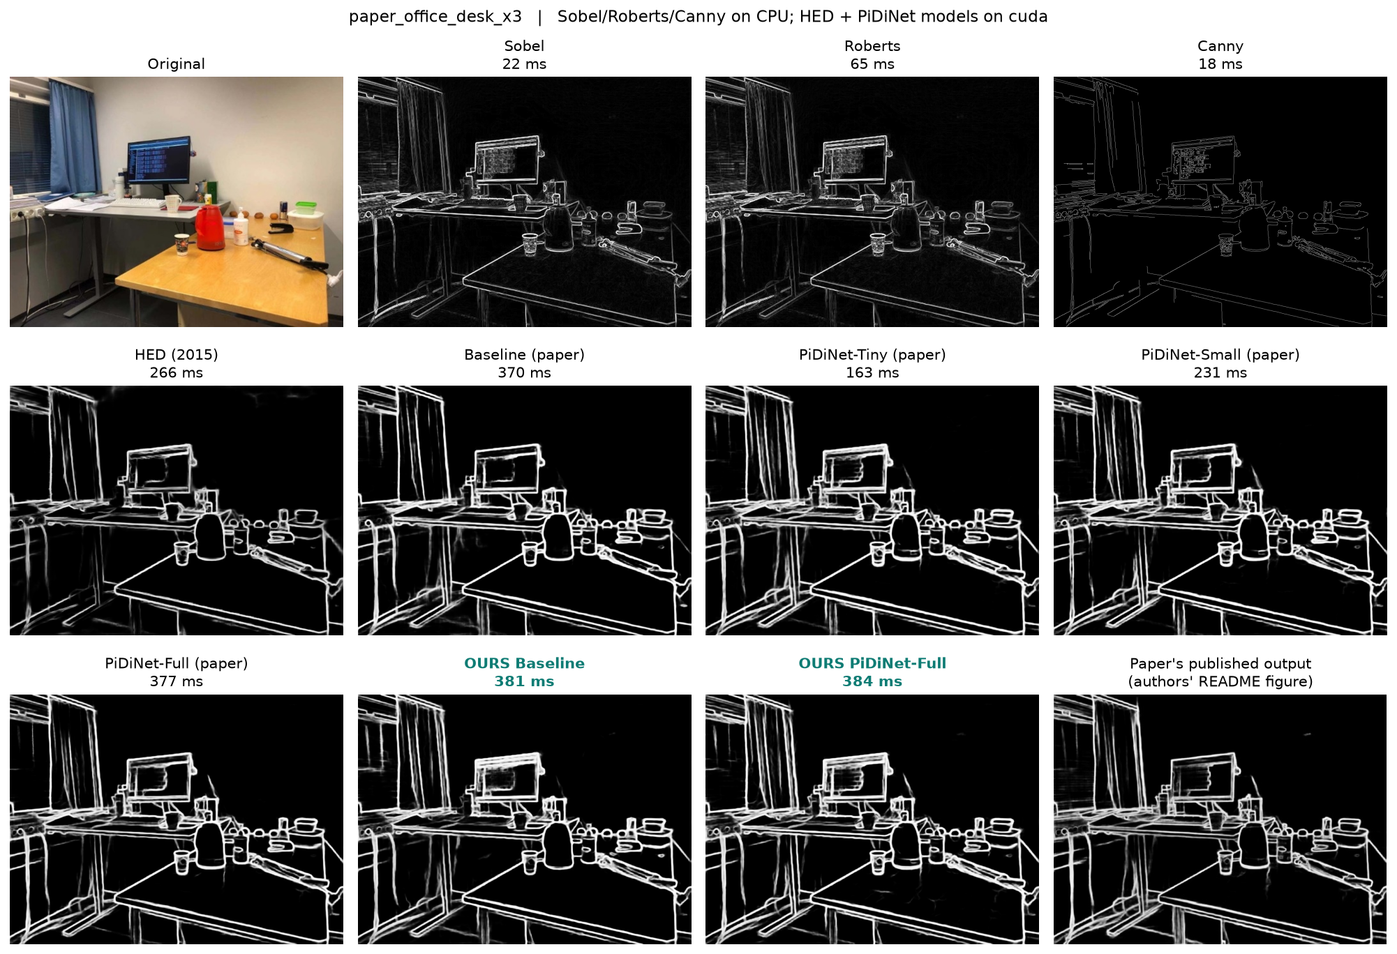
PiDiNet – Code: one notebook, 11 edge detectors (Paper's office photo)
Last panel: the authors' published map from the README figure.
Sobel / Roberts / Canny: main edges only, weak or sparse.
HED: clean but misses the small objects on the desk.
PiDiNet (paper, ours): thin, crisp maps that closely match the authors' output. Input = README thumbnail upscaled x3
Times in the panel titles: Sobel/Roberts/Canny on CPU; HED and PiDiNet on the RTX 4050 GPU.
PiDiNet
DOI: 10.1109/ICCV48922.2021.00507
21

Slide 22
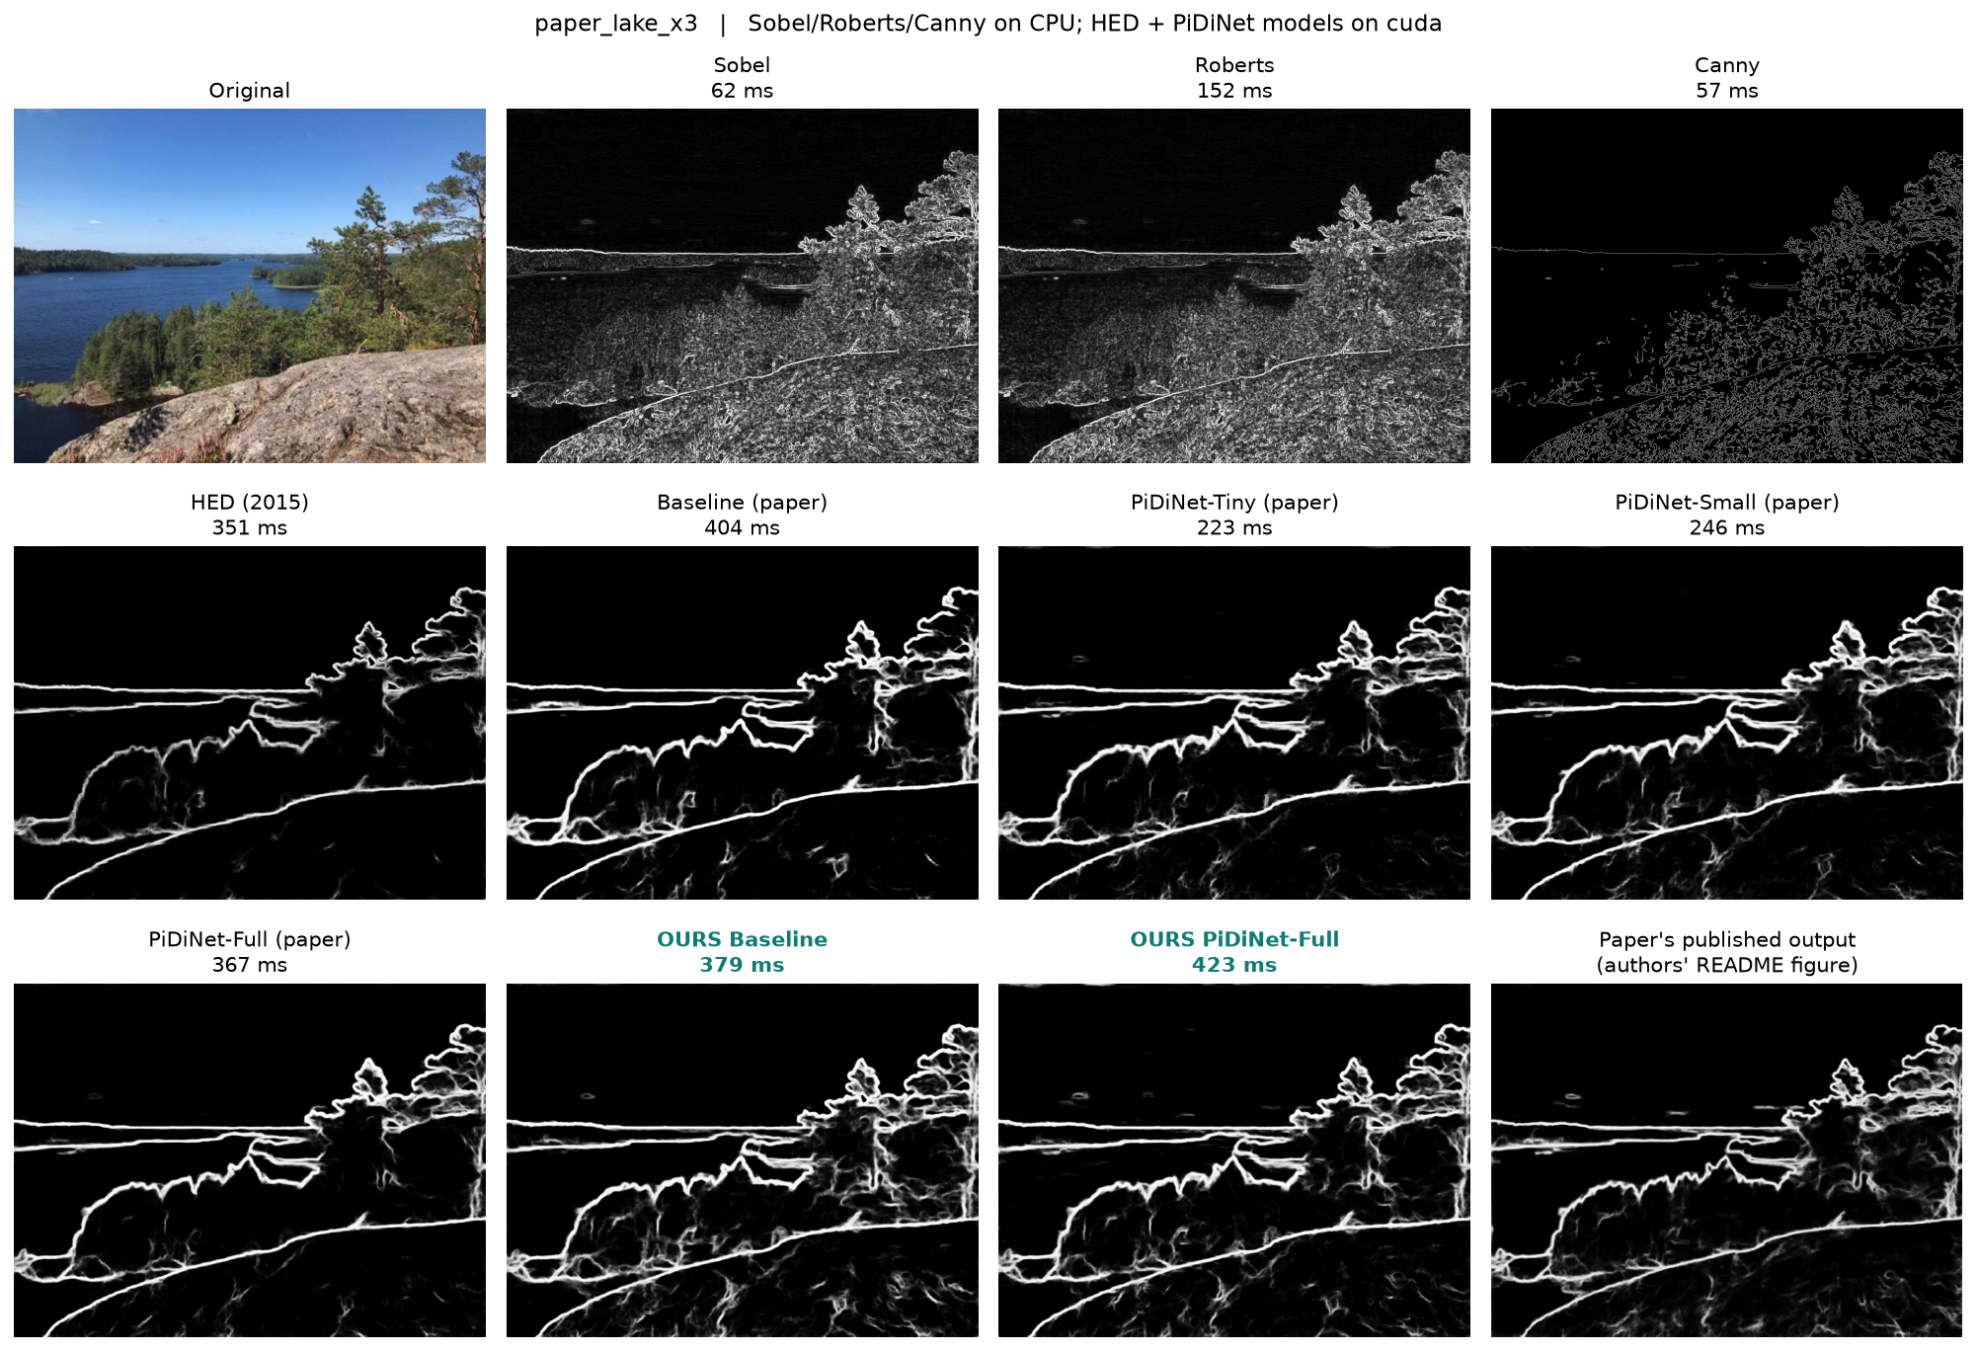
PiDiNet – Code: one notebook, 11 edge detectors (Paper’s lake photo)
Last panel: the authors' published map from the README figure.
Sobel / Roberts / Canny: drown in rock, ripple and foliage texture.
HED: keeps the coastline and trees, drops fine detail.
PiDiNet (paper, ours): coastline, horizon and tree outlines match the authors' output closely. Input upscaled x3.
Times in the panel titles: Sobel/Roberts/Canny on CPU; HED and PiDiNet on the RTX 4050 GPU.
PiDiNet
DOI: 10.1109/ICCV48922.2021.00507
22

Slide 23
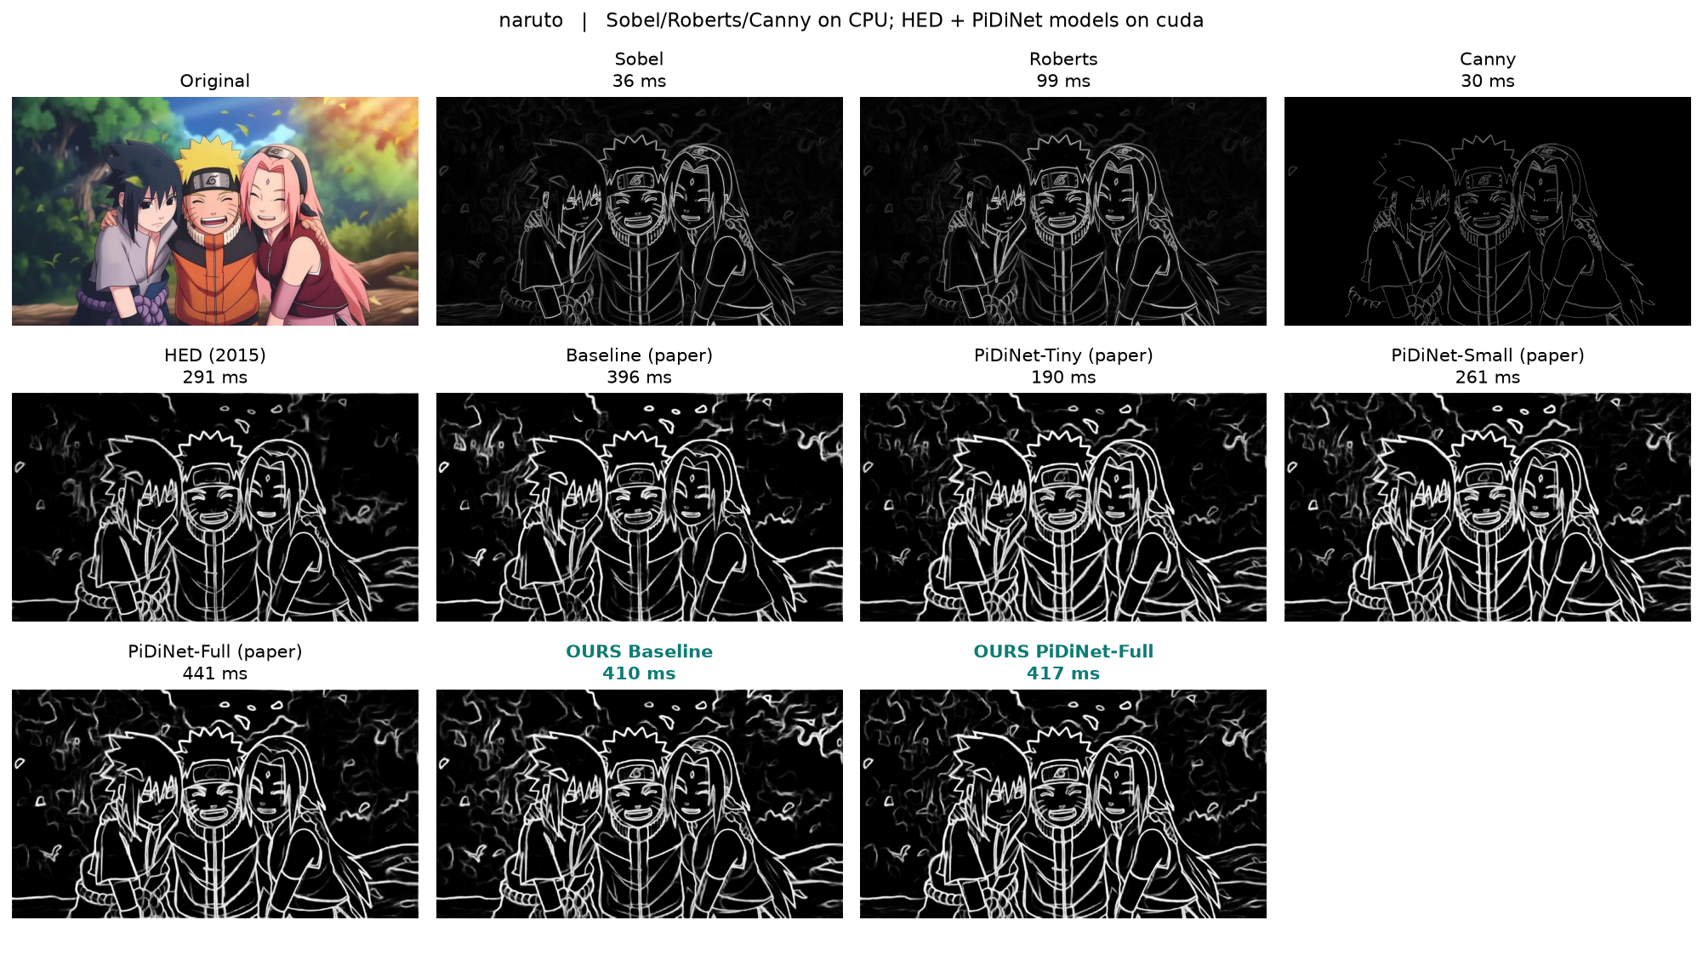
PiDiNet – Code: one notebook, 11 edge detectors (Naruto photo)
Sobel / Roberts / Canny: faint and sparse on the painted frame.
HED: clear faces, hair and clothing with a calmer background.
PiDiNet / Baseline: same subjects, plus more foliage texture in the background.
OURS (teal): match the paper checkpoints on this hardest photo.
Times in the panel titles: Sobel/Roberts/Canny on CPU; HED and PiDiNet on the RTX 4050 GPU.
PiDiNet
DOI: 10.1109/ICCV48922.2021.00507
23

Slide 24
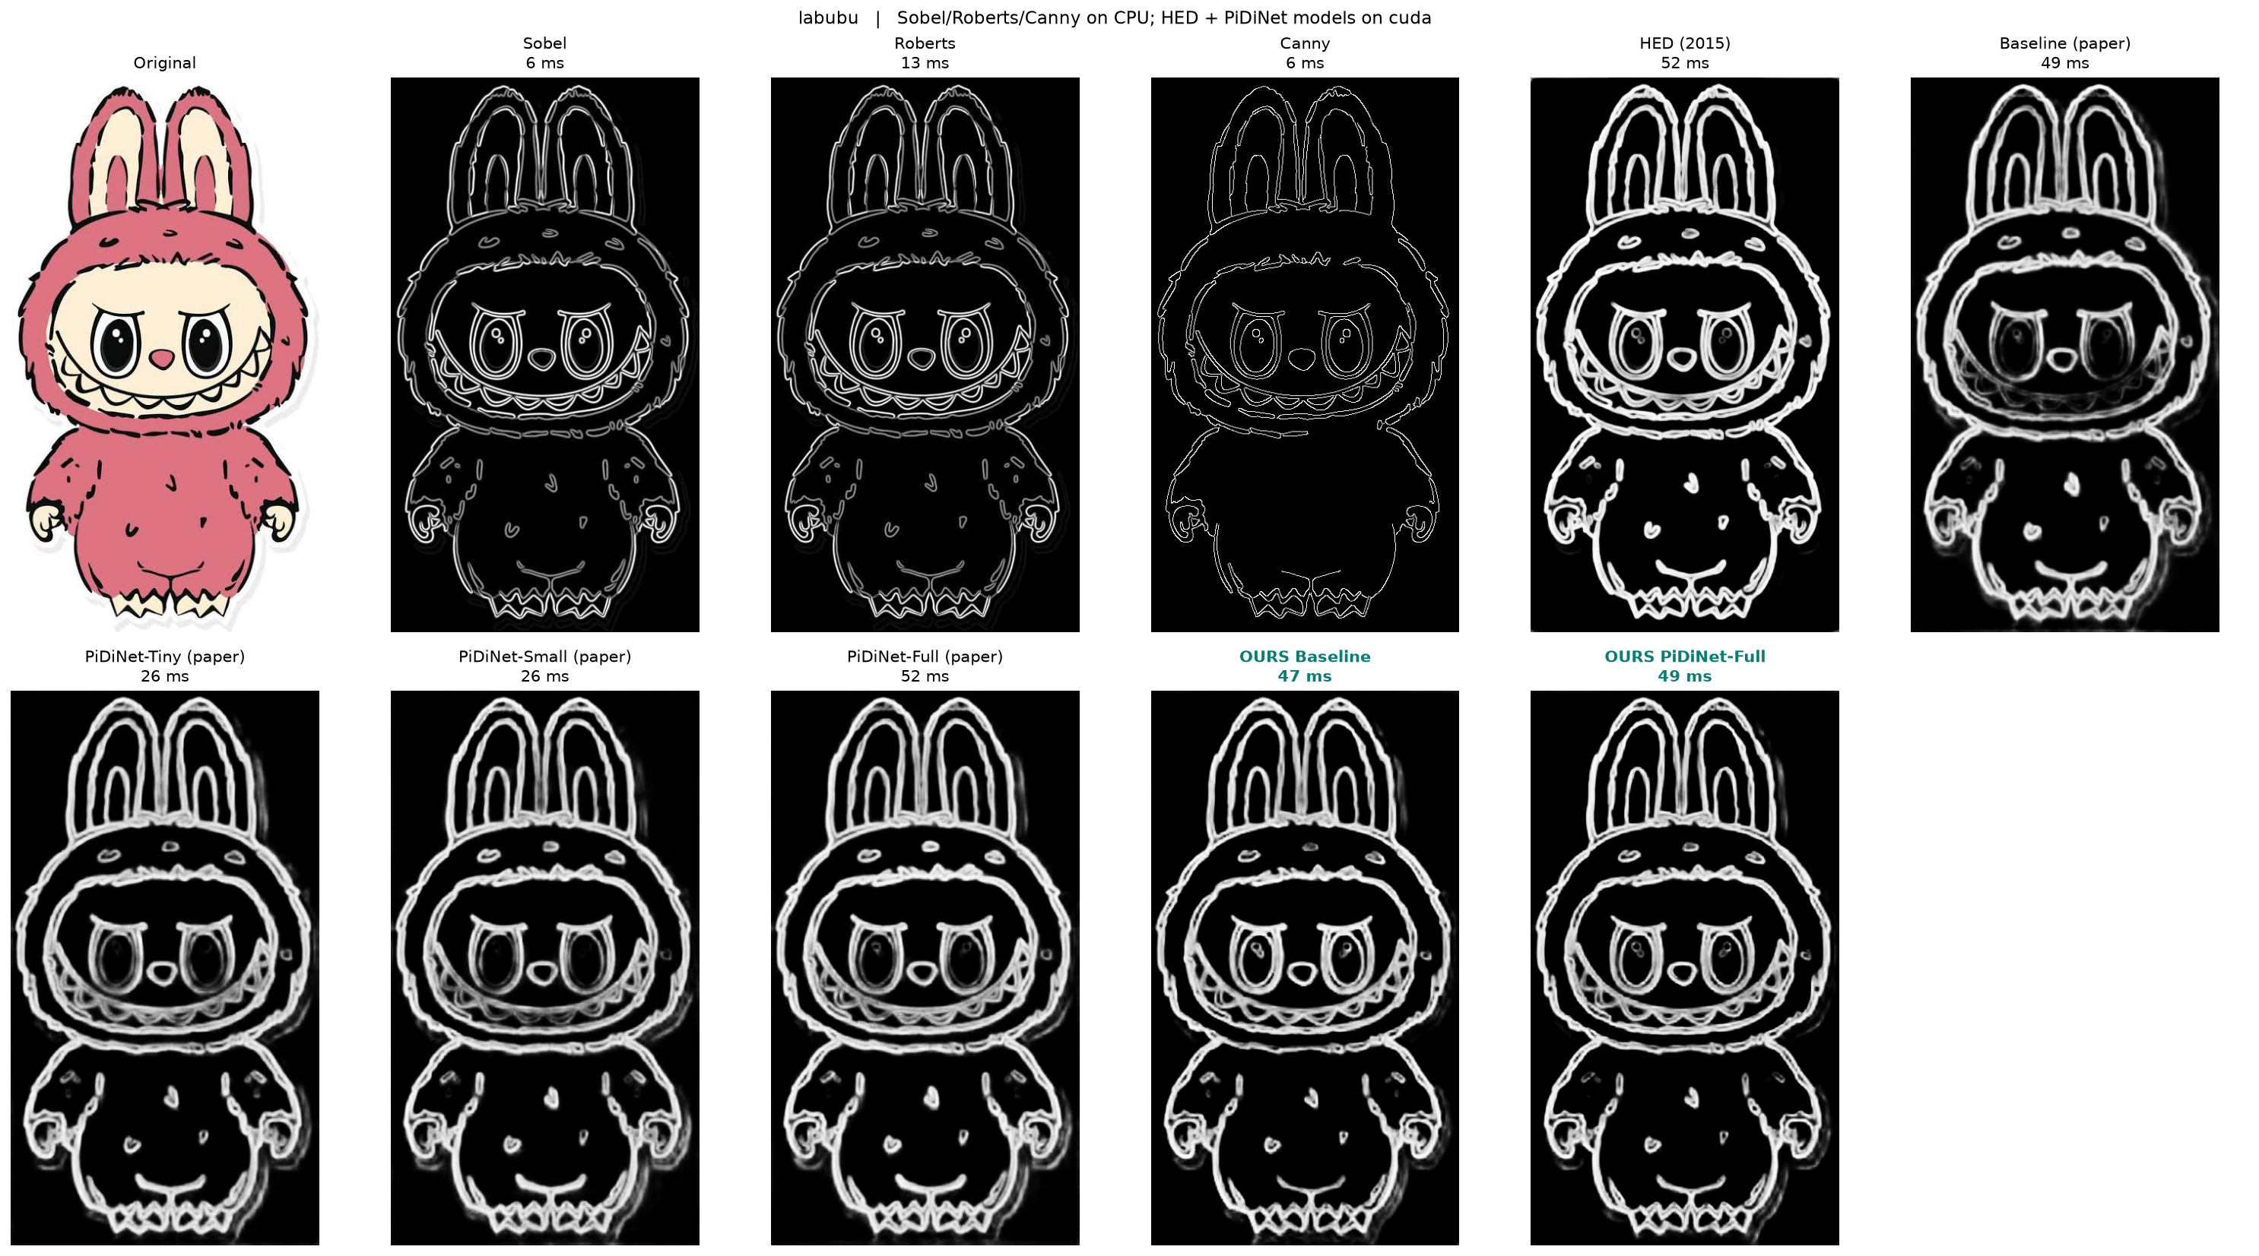
PiDiNet – Code: one notebook, 11 edge detectors (Labubu photo)
Sobel / Roberts / Canny: on clean cartoon line art they give sharp, thin outlines - competitive here.
HED: bold, continuous outlines.
PiDiNet / Baseline: thicker, softer double outlines.
OURS (teal): match the paper checkpoints.
Times in the panel titles: Sobel/Roberts/Canny on CPU; HED and PiDiNet on the RTX 4050 GPU.
PiDiNet
DOI: 10.1109/ICCV48922.2021.00507
24

Slide 25
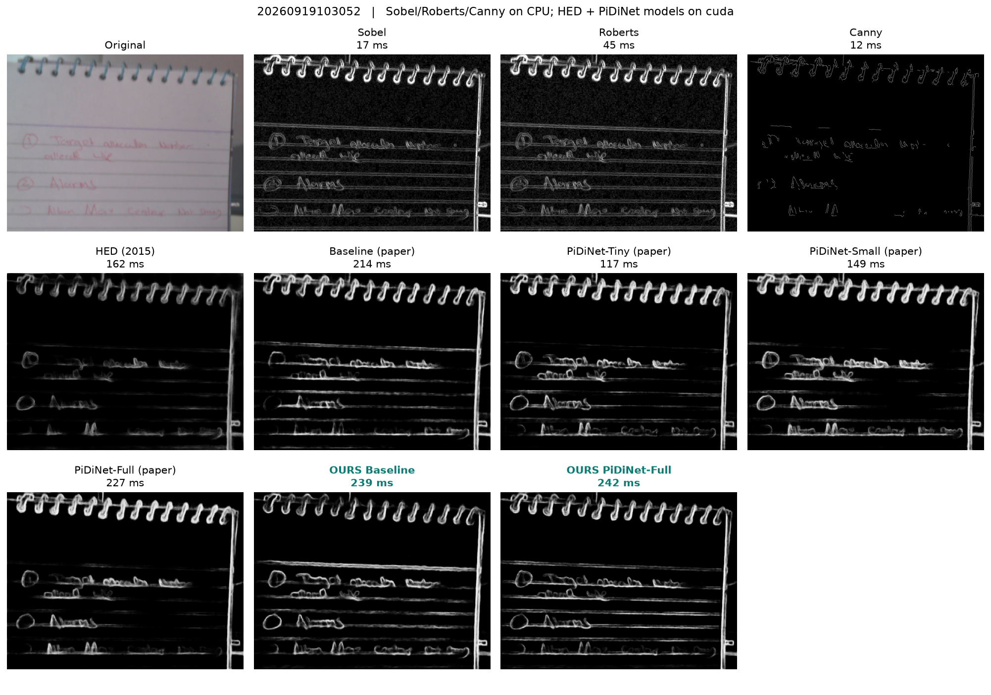
PiDiNet – Code: one notebook, 11 edge detectors (Handwritten note photo)
Sobel / Roberts: show the strokes but also light up the noisy background.
Canny: clean 1px lines yet fragments faint handwriting; much of the text is lost.
HED: smooth but dim on faint strokes.
PiDiNet (paper and ours): most complete: spiral binding and letters both sharp, background clean.
Times in the panel titles: Sobel/Roberts/Canny on CPU; HED and PiDiNet on the RTX 4050 GPU.
PiDiNet
DOI: 10.1109/ICCV48922.2021.00507
25

Slide 26
PiDiNet – References
Paper
Su et al., “Pixel Difference Networks for Efficient Edge Detection,” ICCV 2021 — arXiv:2108.07009
Journal extension
Su et al., “Lightweight Pixel Difference Networks for Efficient Visual Representation Learning,” IEEE TPAMI 2023
Code
github.com/hellozhuo/pidinet — official PyTorch implementation, used as-is for this work
Dataset (raw)
Berkeley BSDS500 (raw release) - www2.eecs.berkeley.edu/Research/Projects/CS/vision/grouping
Dataset (augmented, real)
HED-BSDS.tar (28,800 pairs) - vcl.ucsd.edu/hed/HED-BSDS.tar. mmcheng.net mirror is dead;
PiDiNet
DOI: 10.1109/ICCV48922.2021.00507
26

Slide 27


Slide 28
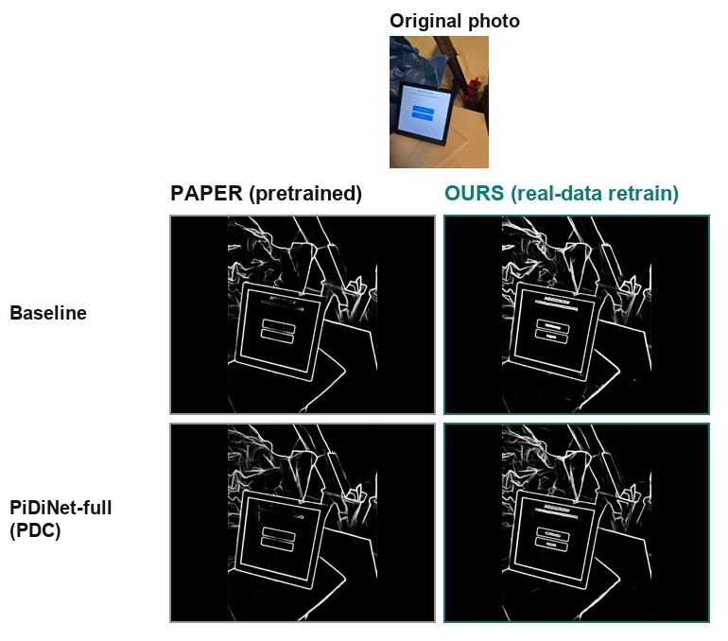
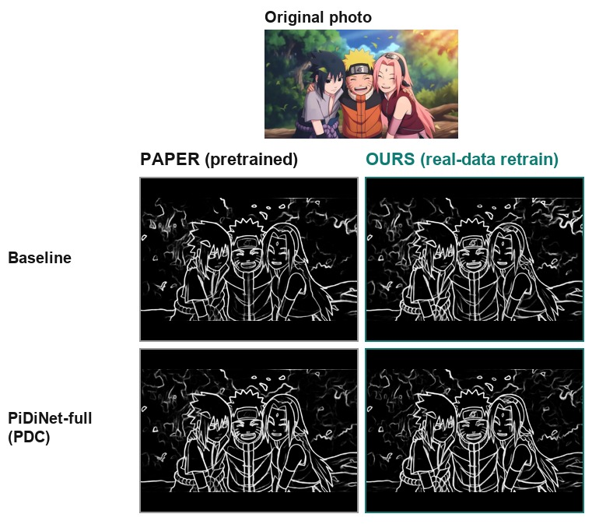
PiDiNet – Paper checkpoint vs our retrain, same photos
PiDiNet
DOI: 10.1109/ICCV48922.2021.00507
28

Slide 29
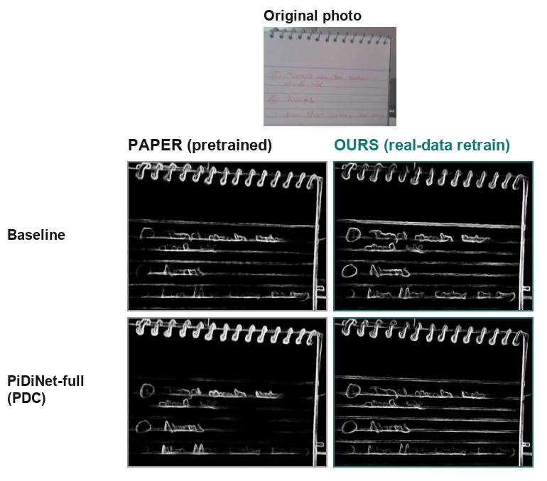
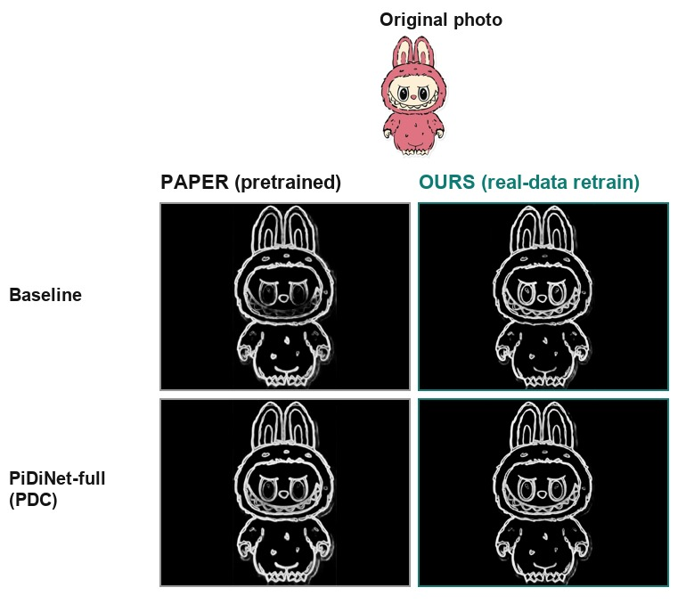
PiDiNet – Paper checkpoint vs our retrain, same photos
PiDiNet
DOI: 10.1109/ICCV48922.2021.00507
29

Slide 30
PiDiNet – Code: one notebook, 11 edge detectors
The four ideas that make the comparison work
1. A registry, loaded once
2. Same timing for every method
PIDINET_MODELS = [
("Baseline (paper)", "pidinet", "baseline", ckpt, False),
("PiDiNet-Full (paper)", "pidinet", "carv4", ckpt, True),
("OURS PiDiNet-Full", "pidinet", "carv4", our_ckpt, True)]
LOADED = {lbl: load_pidinet(a, c, k, v) ...} # once
def timed(fn, *a, n=3):
fn(*a) # warm-up (CUDA start-up)
t = time.perf_counter()
for _ in range(n): out = fn(*a)
return out, (time.perf_counter() - t) / n * 1000
outs[name], ms[name] = timed(fn, arg)
3. HED on the GPU
4. Fairness choices
CAFFE_NAME = {"conv1_1": "conv1_1", ...,
"score_dsn1": "score-dsn1-up",
"score_final": "upscore-fuse"}
w, b = hed_net.getLayer(id).blobs # Caffe weights
layer.weight.data.copy_(torch.from_numpy(w)) # PyTorch HED
# GPU vs OpenCV output: correlation 0.93-0.97
Canny's thresholds come from each image's own gradient (95th percentile), because fixed 50/150 gave a blank map on the low-contrast photo. Sobel and Roberts are clipped at the 99th percentile so faint edges show. PiDiNet uses the last of its 5 outputs (the fused map). Classical filters run on CPU and the deep models on GPU, so compare speeds within a group.
PiDiNet
DOI: 10.1109/ICCV48922.2021.00507
30

Slide 31
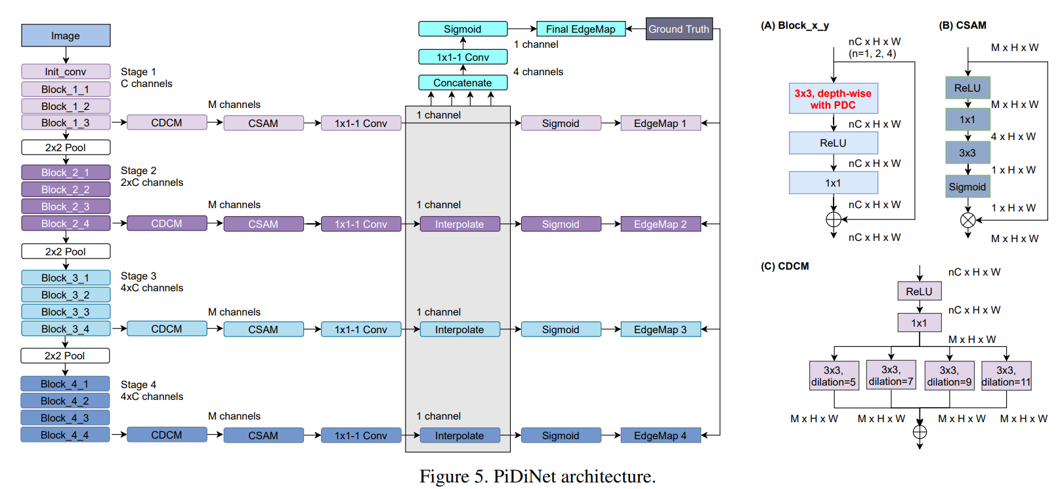
PiDiNet – Architecture
PiDiNet
DOI: 10.1109/ICCV48922.2021.00507
31

